Slide 1
AR-HOST
By
SpiritView
Nasheeth Ahmed A
Ansar Basha J
Harsh Kumar Dubey M
Kalaiganesh R
Suriyaganesh J T
Kingston Engineering College

Slide 2

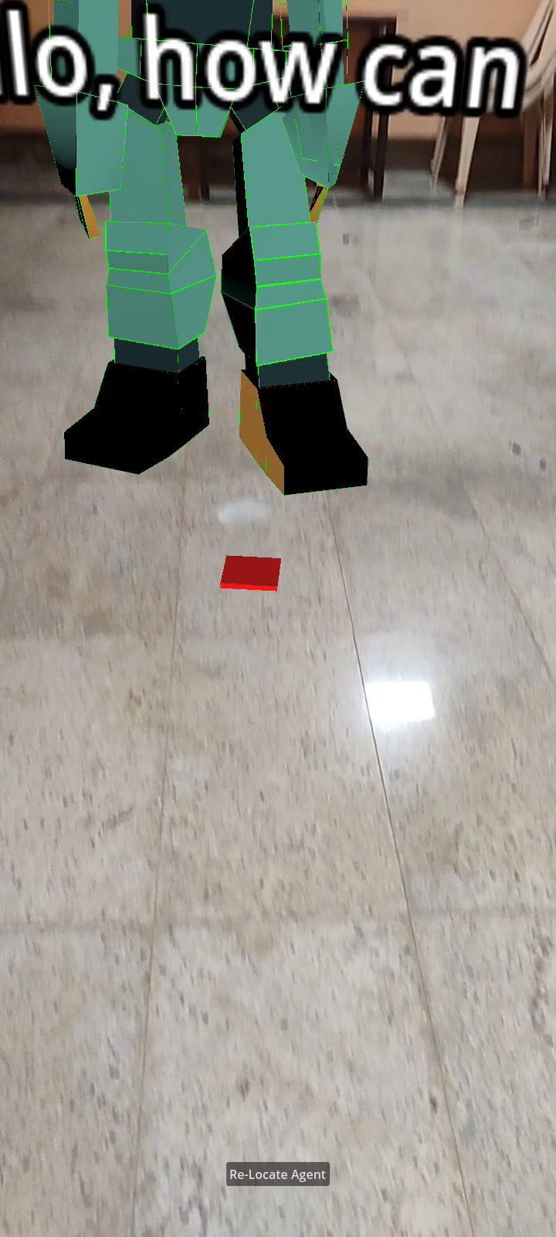



ARCORE +
Android
GODOT +
N8N

Slide 3
The Why & The What: Our Project's Core Objective
Validated Problem Statement
The overarching challenge is the lack of a scalable, accessible, and engaging platform for digitizing and experiencing cultural heritage. Existing methods often fail to deliver immersive historical narratives and struggle to reach users in areas with limited internet infrastructure.
Key User Pain Point
Traditional heritage experiences are largely passive, generic, and exclusionary, often relying on static information or basic audio guides that lack personalization and multilingual depth. This leads to missed educational opportunities, low user engagement, and limits the reach of cultural preservation efforts to a global, diverse audience.
Real-time, multilingual conversations (NLP).
The plug-and-play content dashboard for instant setup.

Slide 4
Prototype Overview
Unmatched Accessibility :
Delivers rich AR experiences even in low-bandwidth areas using adaptive asset loading and offline dialogues.
Pinpoint Spatial Accuracy:
Uses Geospatial APIs to anchor persistent, life-sized AR content with centimeter-level precision.
Open-Source Flexibility:
Built on an open-source core (Godot, n8n) for unparalleled customization and lower operational costs.
AR Agents:
Agents providing real-world help beyond the tour.
Example feedback/complaint registering, nearest hotel etc.

Slide 5
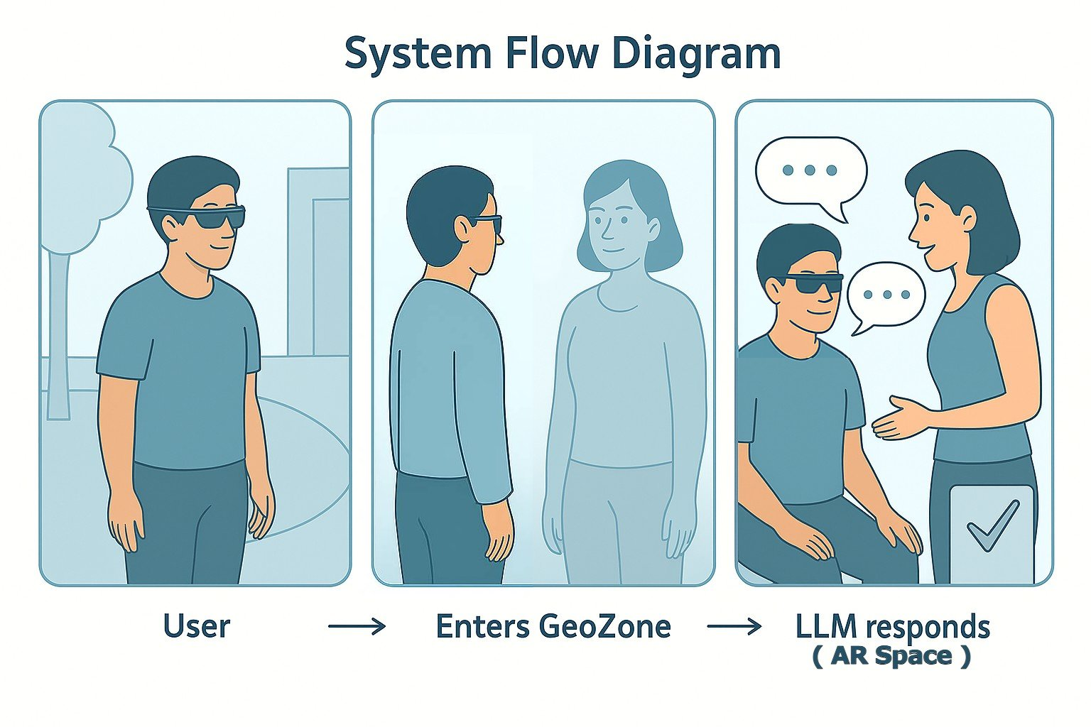
User Experience & Impact
Conversational, narrative-driven experiences instead of static AR visuals.
A creator dashboard for customizing agents, stories, and environments at scale.

Slide 6
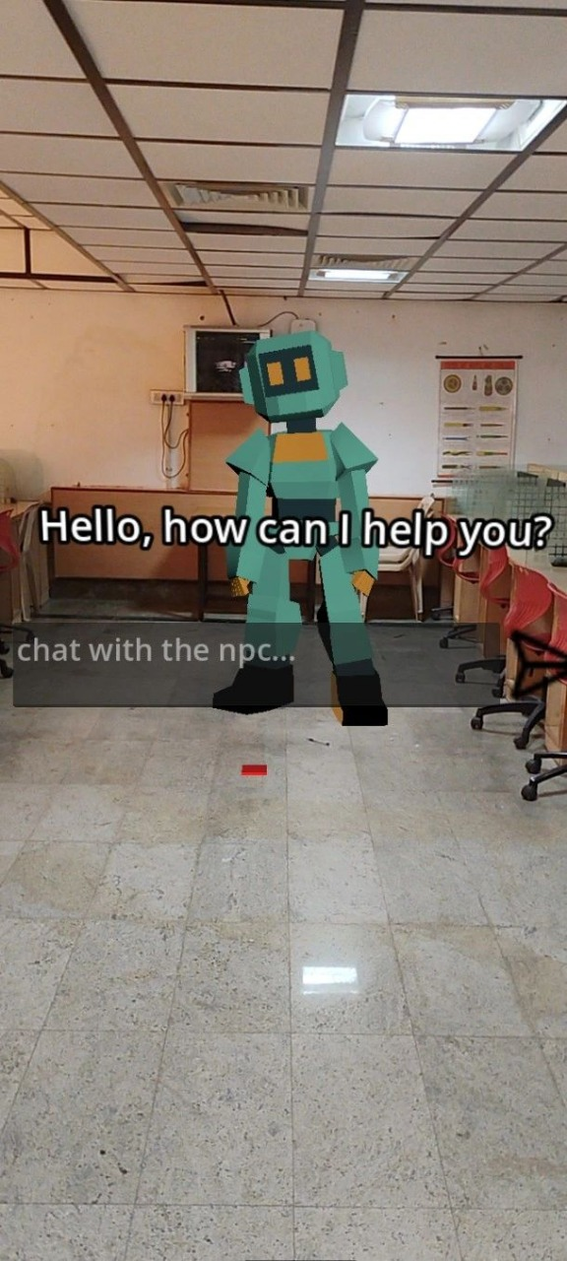
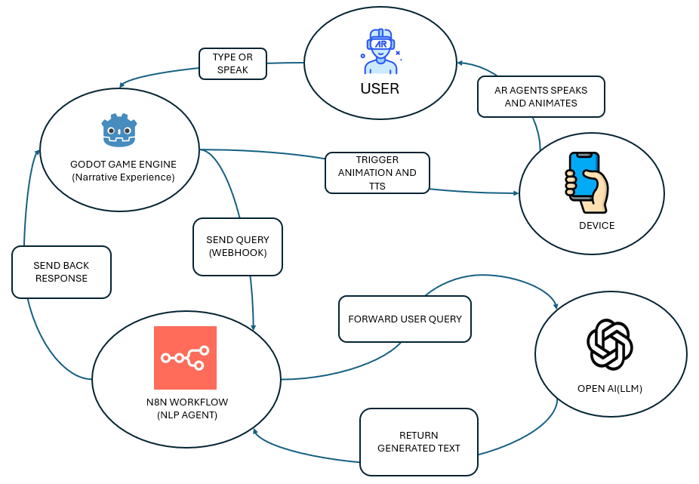
Screen Shot & Flow Chart

